Slide 1
Periodontal Diseases

Slide 2
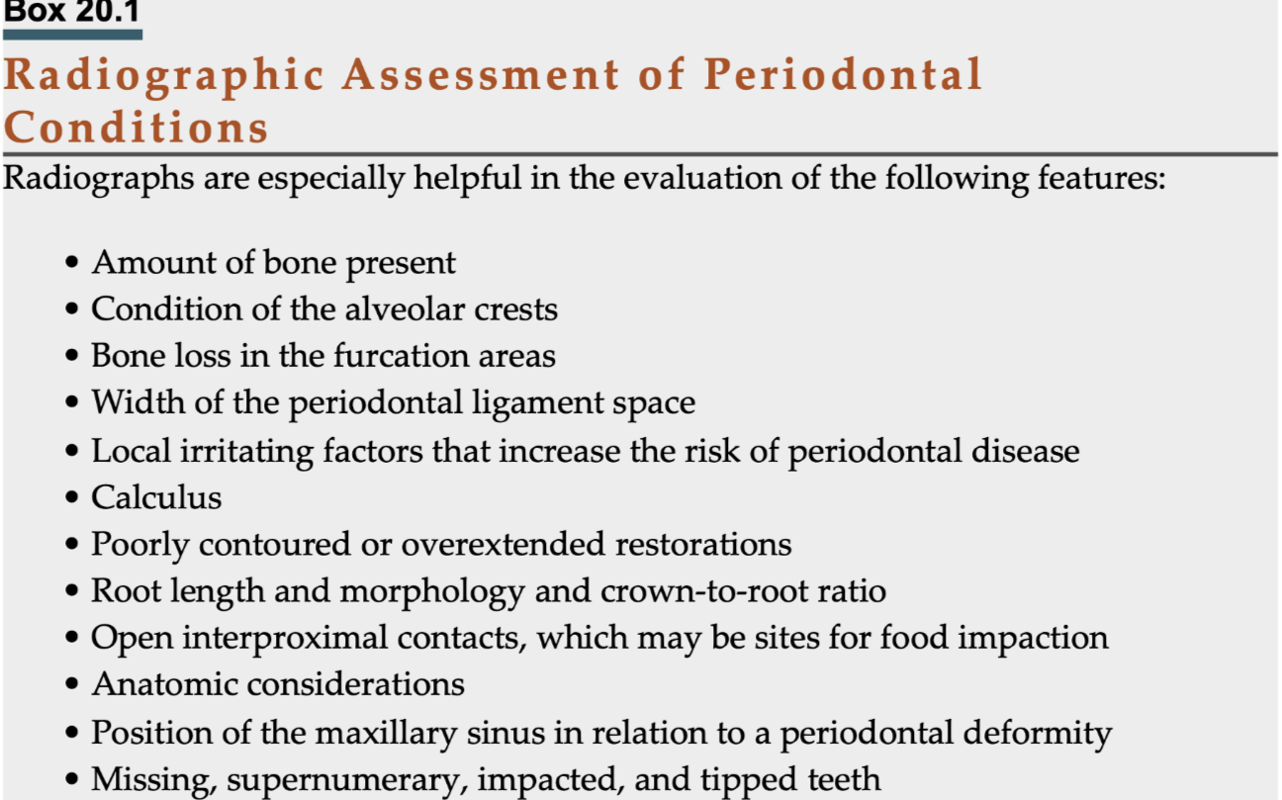
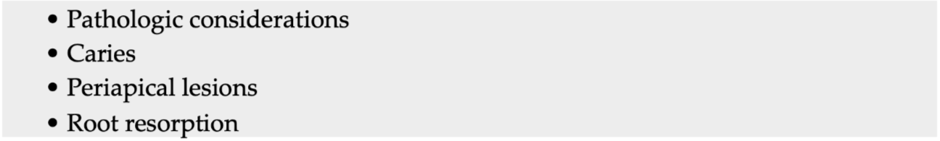
The periodontium supports the teeth in the jaws, and is composed of the gingiva, the periodontal ligament (PDL), cementum, and the alveolar processes of the jawbones.
In the diagnosis of the periodontal diseases, the clinical and radiologic examinations are complementary.
prescription of imaging is indicated when the clinical examination suggests periodontitis

Slide 3
Imaging Modalities for the Assessment of Periodontal Disease
Intraoral Imaging
highest spatial resolution
Bitewing images should be considered the primary imaging choice
most accurately >>> distance between the CEJ and the crest of the alveolar process
periapical images: distorted /obliquity of the primary x-ray beam
most commonly in the maxilla because of palatal vault >>> level of the buccal alveolar crest may be projected near or above the level of the palatal CEJ, making the bone height appear greater than it actually is
(1) no overlapping of the interproximal contacts between the tooth crowns
(2) no overlapping of the roots of adjacent teeth
(3) the buccal and lingual cusps of molars are superimposed over one another

Slide 4
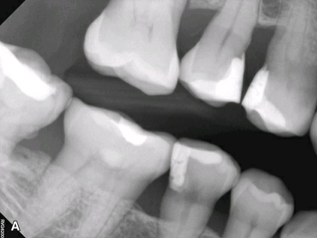

Slide 5
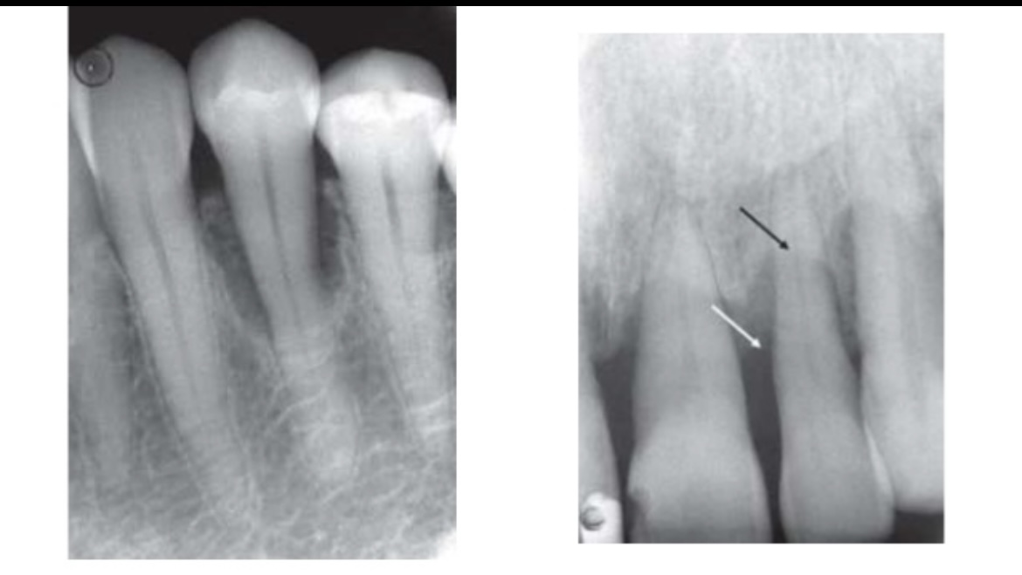
Limitations of Intraoral Images
1. two-dimensional representations of three-dimensional anatomic structures
interproximal bony defects may not be effectively visualized, as the buccal and/orlingual walls may superimpose themselves
the subtle decrease in the apparent density of the root structure (i.e., where the root may appear more radiolucent) may indicate bone loss on the buccal or lingual surface of the root.
2. show less severe bone loss than is actually present
3. do not demonstrate soft tissue-to-hard tissue relationships (pockets depth)
4. severe attrition >>> supra eruption or passive eruption >>> not valid bone level to CEJ

Slide 6
Panoramic Imaging
superimpositions and distortions (particularly in the anterior areas of the jaws)
Some authors suggest that a panoramic image supplemented with selected intraoral images may be adequate for periodontal assessment. However, unless a panoramic system is already available or prescribed for another diagnostic query, the use of panoramic imaging as a primary imaging tool for characterizing periodontal disease is discouraged.

Slide 7
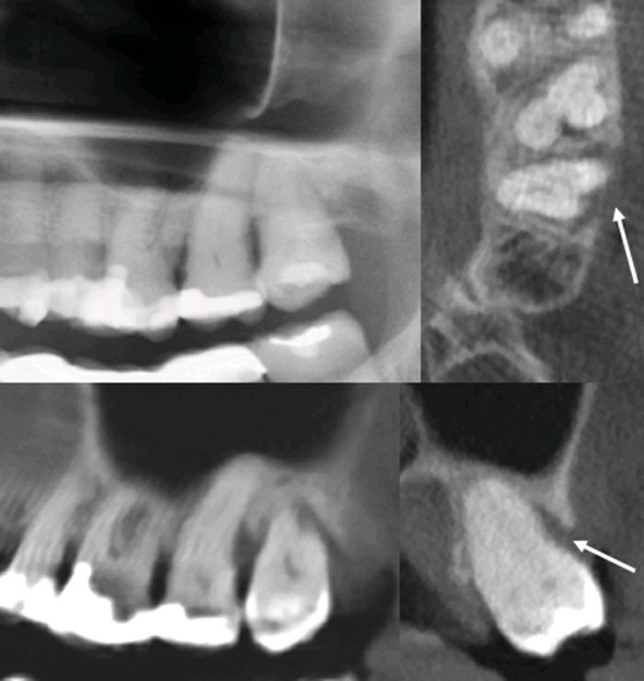
Cone Beam Computed Tomography
Complex vertical defects
Craters
Furcations
Buccal and lingual cortical plate loss
Anatomic features (root morphology)
Cortical fenestration
Periapical pathosis
CBCT imaging, particularly small-volume and high resolution systems, may be indicated in guiding the management of selected bony lesions, especially when surgery is being considered.

Slide 8
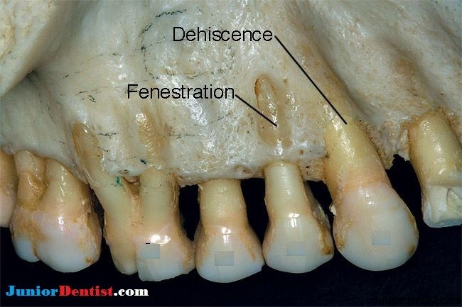

Slide 9
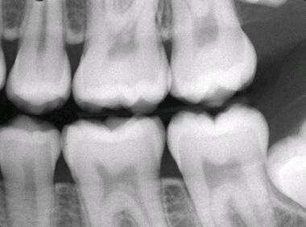
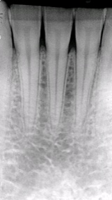
Appearance of Normal Anatomy
A thin layer of radiopaque cortical bone often overlies the crest of the alveolar process,
height of the crest : approximately 0.5 to 2.0 mm apical to CEJs
Between posterior teeth: alveolar crest is oriented parallel to an imaginary line connecting adjacent CEJs
between anterior teeth: the alveolar crest is a point between the teeth
well-mineralized cortical surface to the alveolar crest indicates the absence of periodontitis. However, a lack of a well-mineralized alveolar crest may be found in patients both without and with periodontitis.

Slide 10
alveolar crest is continuous with the lamina dura
absence of disease in posterior teeth : sharp angle
PDL space: thin, even, radiolucent space
slightly wider around the cervical portions of tooth roots, particularly the premolar teeth, and in adolescents with erupting teeth >>> normal if the lamina dura still forms a sharp, well-defined angle with the alveolar crest
The buccal/lingual thickness of the alveolar crest varies widely, and it may be very thin coronally >>> appear in a two-dimensional image as an increase radiolucency toward the crest

Slide 11
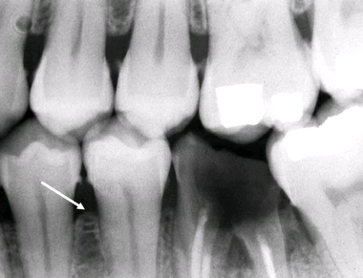
Imaging Features of Periodontal Diseases
gingivitis is an inflammatory condition confined to the gingiva, there are no changes to the underlying bone >>> normal image
acute early lesions >>> bone loss
chronic lesions >>> bone sclerosis
Changes in Morphology of Alveolar Processes
Early Bone Changes
Localized erosion of the interproximal alveolar crest
anterior regions >>> blunting of the alveolar crests and slight loss of alveolar crestal bone height
posterior regions >>> loss of the normally acute angle between the lamina dura and alveolar crest

Slide 12
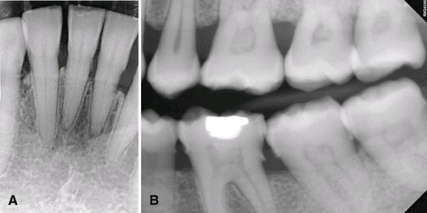
Horizontal Bone Loss
loss in height of the alveolar process where the crest is still horizontal
buccal and lingual cortical plates and the interdental bone have been resorbed

Slide 13
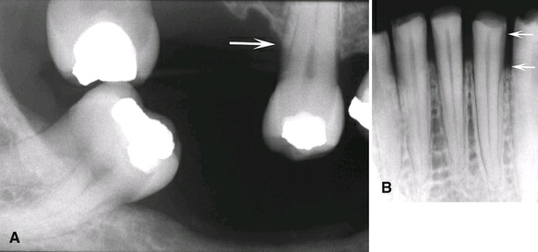
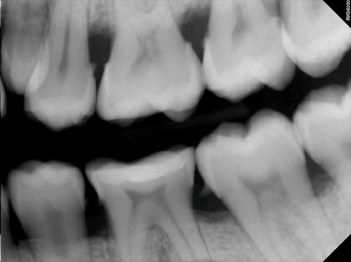
When the CEJs of adjacent teeth are at different horizontal levels, the alveolar crest may have an angled appearance. should not be confused with a true vertical (angular) bone defect
Care must also be taken in using the CEJ as a reference point in cases of tooth supra eruption and severe attrition. With supra eruption, the alveolar process will not necessarily remodel so that a normal relationship is maintained to the CEJ.

Slide 14
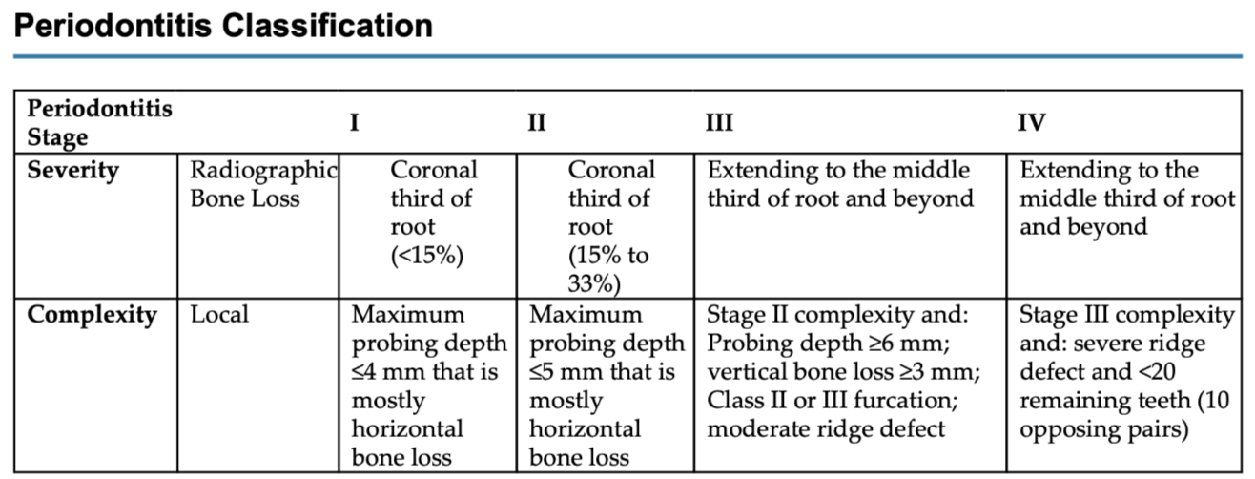
Early stage (I) bone loss >>>up to 15% of the tooth root length, or a probing depth of 4 mm or less
Stage II bone loss between >>> 15% and 33% of the root length, and probing depths of up to 5mm
Stages III and IV bone loss >>> middle-third of the tooth root and beyond, with probing depths of 6 mm or more

Slide 15
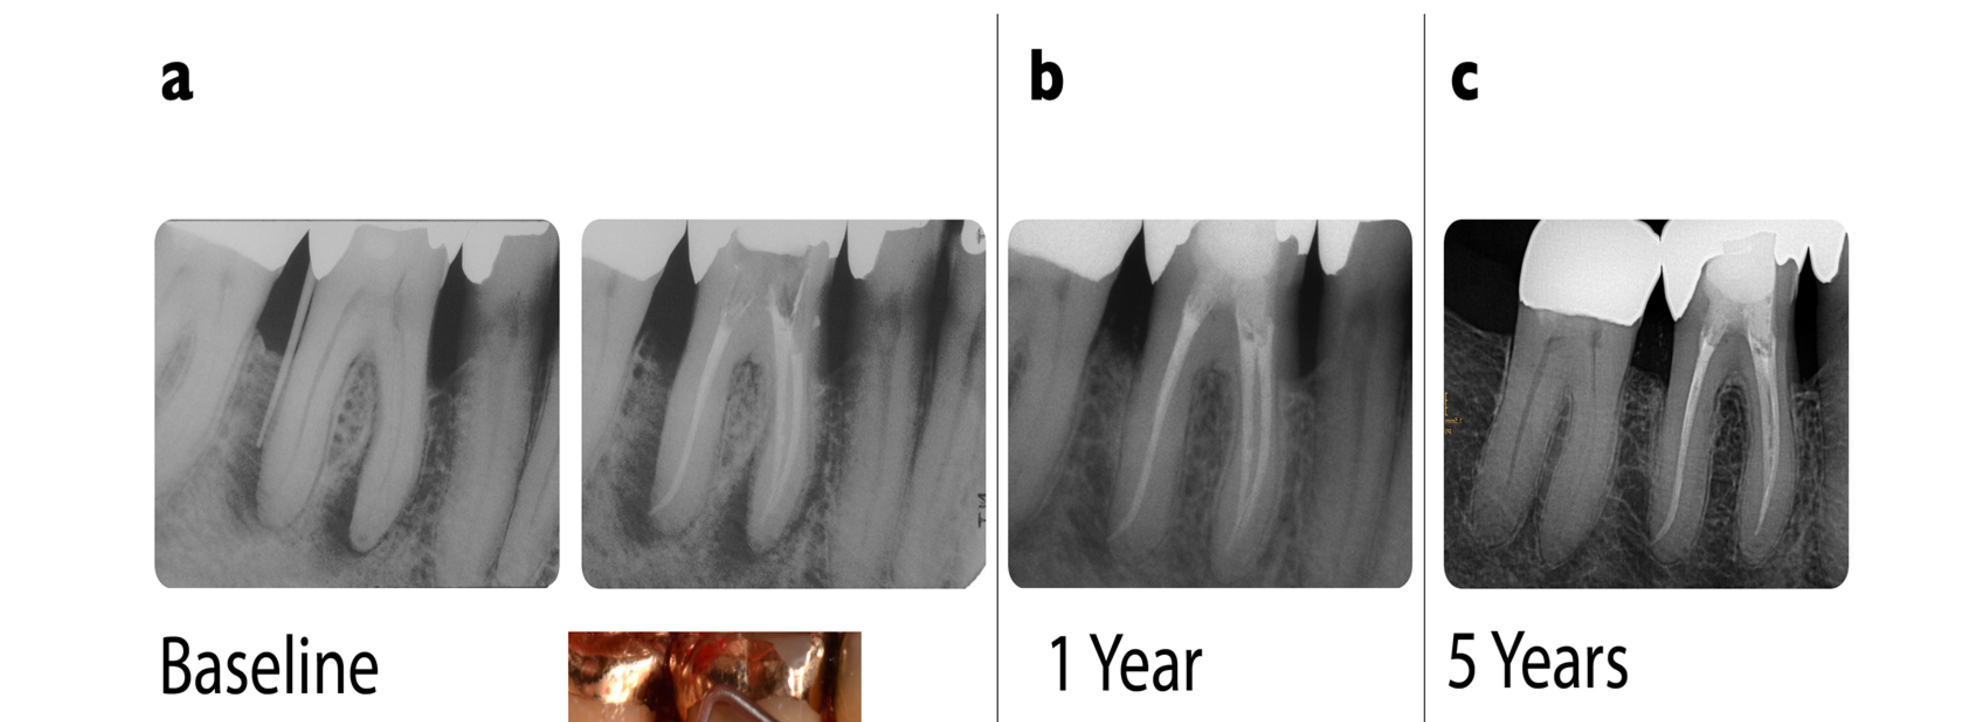
It is important to recognize that the extent of bone loss evident at a single examination does not indicate the current activity of the disease. For example, a patient who previously had generalized periodontal disease and subsequent successful therapy will show reduced bone height, but the bone level may remain stable.
Reestablishment of the cortication of the alveolar crest is a good indicator of stabilization of the periodontium.

Slide 16
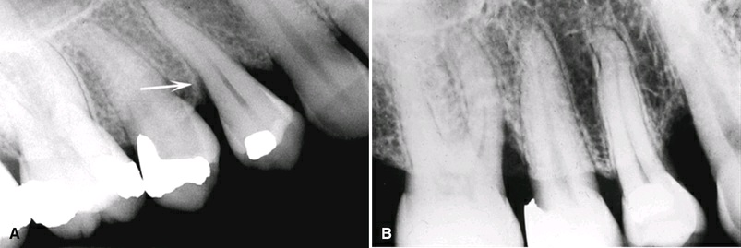
Vertical Bone Defects
or angular, infrabony
associated with Stages III and IV periodontitis
resulting in a deepening of the periodontal pocket
V- or triangular-shaped defect within the bone that extends apically along the root
An angulation that is oblique to an imaginary line connecting the CEJ
In its early form: abnormal widening of the PDL space at the alveolar crest

Slide 17
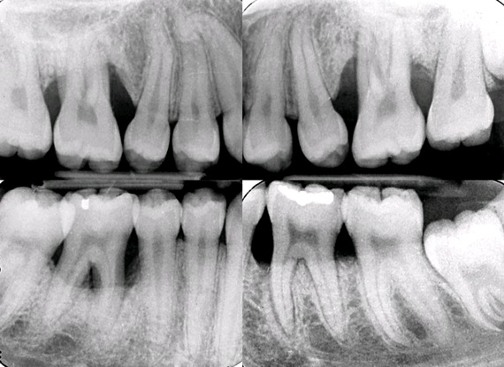

Slide 18
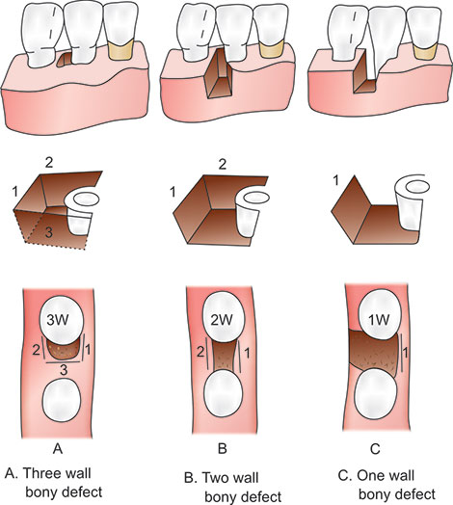
three-walled (surrounded by three bony walls) : when both the buccal and lingual cortical plates remain intact
Two walled : one of these plates has been resorbed
one-walled: both plates have been lost

Slide 19
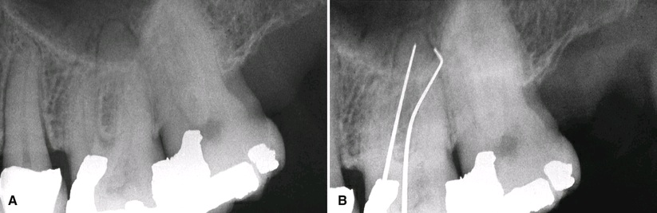
The number of walls associated with a vertical defect is difficult or impossible to recognize on intraoral images,
inserting a gutta-percha point before making the intraoral image
Clinical and surgical inspections are the best
CBCT (not be routinely)

Slide 20
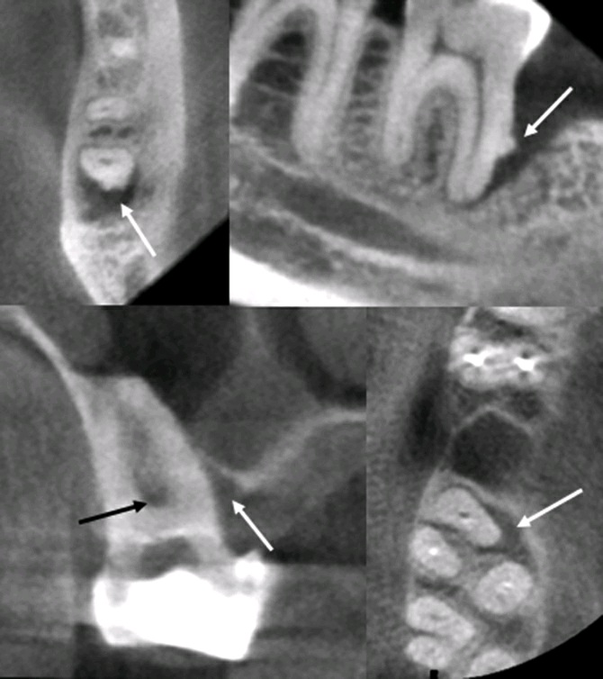

Slide 21
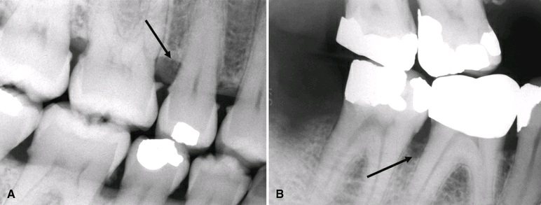
Interdental Craters
a two-walled, trough-like depression that develops in the crest of the alveolar process between adjacent teeth.
The buccal and lingual outer cortical walls of the interproximal bone extend further coronally than the cancellous bone between them
bandlike or irregular region of bone with less density at the crest,
more common in the posterior segments /broader buccal-lingual dimension

Slide 22
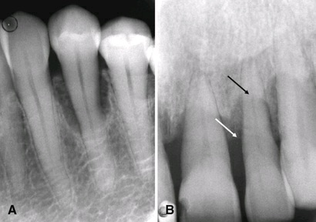
Buccal or Lingual Cortical Plate Loss
increase in the radiolucency of the tooth root near the alveolar crest.
semicircular, with the depth of the radiolucency directed apically in relation to the tooth
Lack of bone loss at the interproximal region of the tooth may make this kind of defect difficult to detect on conventional images.

Slide 23
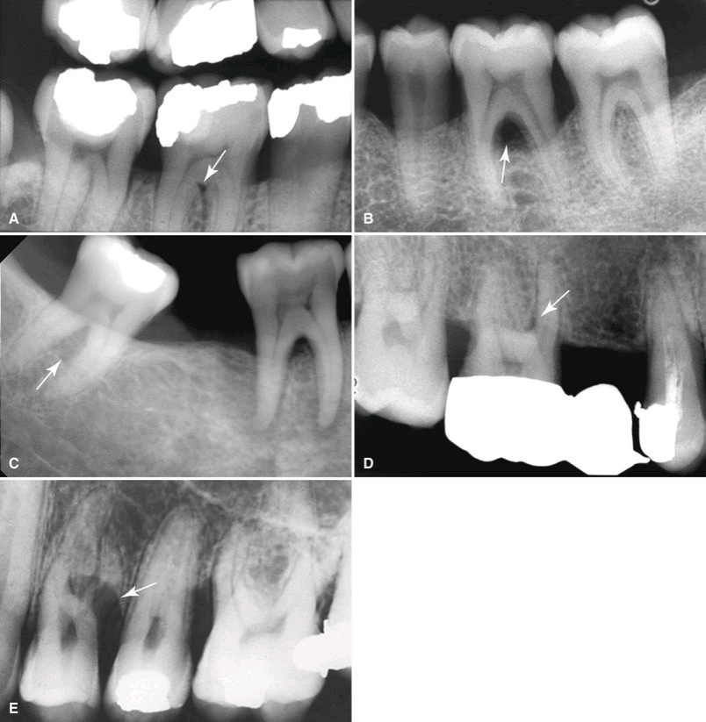
Osseous Deformities in the Furcations of Multirooted Teeth
Widening of the PDL space at the apex of the interradicular bony crest of the furcation
sufficient loss >>> defect becomes prominent
involve only the buccal or lingual cortical plate<<< furcation may appear more irregular and radiolucent than the adjacent normal bone (buccal object )
In the mandible, the external oblique ridge may mask furcation involvement of the third molars

Slide 24
Convergent roots may also obscure furcation defects in maxillary and mandibular second and third molars
maxillary molar: buccal, mesial, or distal surfaces of the tooth (most common mesial)
palatal root superimpose over the defect in maxillary molars >>> not as sharply defined as mandibular molars
inverted “J-shape” radiolucency, with the hook of the “J” extending into the furcation
radiolucent triangle (apex pointing toward the furcation)
definitive diagnosis : clinical examination and surgical exploration

Slide 25
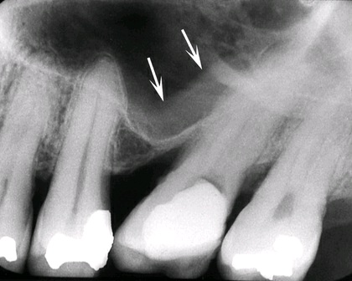
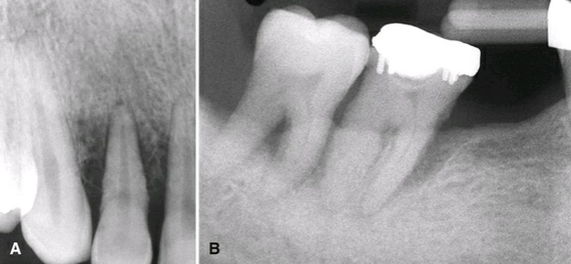
Changes to the Internal Density and Trabecular Pattern of Bone
The peripheral bone may appear more radiolucent or radiopaque, or more commonly mixture
Radiolucent : loss of density and number of trabeculae, trabeculae appear very faint (early or acute lesions )
radiopaque or sclerotic : deposition of bone on existing trabeculae , thicker trabeculae, eventually amorphous radiopaque mass, inflammatory products from a periodontal
floor of the maxillary sinus to cause a regional mucositis
In rare cases, a periosteal reaction

Slide 26
Classification of the Periodontal Diseases
All the types of changes in bone morphology or trabecular pattern described above may be present to varying degrees in any patient with periodontitis.
The same bone changes can also present in necrotizing periodontitis and periodoontitis as a manifestation of systemic disease.

Slide 27
Necrotizing Periodontal Diseases (NPD)
necrotizing gingivitis and necrotizing periodontitis
HIV infection, malnutrition, stress, and smoking
The diagnosis: made by clinical examination, but imaging aids in characterizing the extent of the bone loss.

Slide 28
Periodontitis as a Manifestation of Systemic Disease
periodontal destruction is a manifestation of a systemic condition
hematologic diseases (e.g., acquired neutropenia and leukemia)
genetic diseases (e.g., familial or cyclic neutropenia, Down syndrome, leukocyte adhesion deficiency syndrome, Papillon-Lefèvre syndrome, and Chédiak-Higashi syndrome)
Papillon-Lefèvre syndrome:
history of premature loss of deciduous teeth
the permanent teeth are rapidly lost soon after erupting
hyperkeratosis of palmar and plantar surfaces.

Slide 29
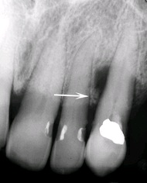
Other Conditions Affecting the Periodontium
Periodontal Abscess
destructive lesion that usually originates in a deep soft tissue periodontal pocket
when the coronal portion of the pocket becomes occluded
when foreign material becomes lodged between a tooth and the gingiva
Acute: no visible changes in the image
lesion persists: a radiolucent region appears, often superimposed over the root of a tooth. The radiolucency may be a focal, round area of rarefaction, with loss of the lamina dura on the involved root surface, and a bridge of bone may be present over the coronal aspect of the lesion

Slide 30
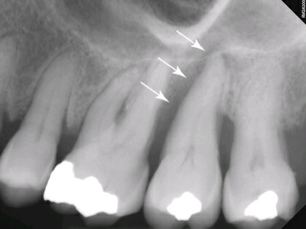
Endodontic-Periodontic Lesions
periodontal or pulpal origin may develop independently and merge with one another or one lesion may induce the other
as a deep angular bone defect on imaging, concomitant focus of periapical rarefying osteitis
uniform width or widens slightly at the alveolar crest, creating a funnel-like shape

Slide 31
Occlusal Trauma
Traumatic occlusion >>> degenerative changes in bone
clinical signs and symptoms:
increased mobility
wear facets
unusual response to percussion
history of contributing habits
findings in the images:
Widening PDL
thickening of the lamina dura
bone loss
increase in the number and size of trabeculae
hypercementosis
root fractures
Traumatic occlusion alone does not cause gingivitis or periodontitis, affect the epithelial attachment, or lead to pocket formation. However, in the presence of preexisting periodontitis, bone loss may be accelerated.

Slide 32
Tooth Mobility
Widening of the PDL space suggests tooth mobility, which may result from occlusal trauma or a lack of bone support arising from advanced bone loss.
single root tooth: socket may develop an hourglass shape
Multirooted tooth: widening of the PDL space at the apices and in the region of the furcation
lamina dura may appear broad and hazy, and show increased density.

Slide 33
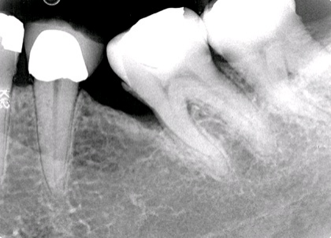
Open Contacts
Open contacts are associated with sites of periodontal disease more than closed contacts.
does not cause periodontal disease but, again, provides an environment where disease may develop

Slide 34
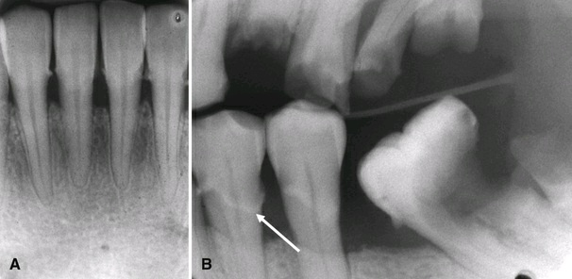
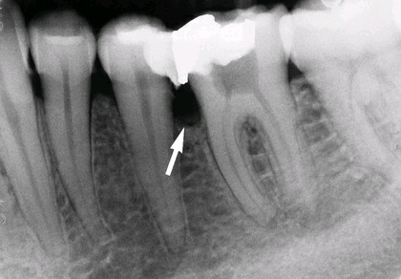
Local Irritating and Factors

Slide 35
Other Modifiers of Periodontal Disease
HIV infection and acquired immunodeficiency syndrome (AIDS)
high incidence and severity of periodontal disease
characterized by a rapid progression that leads to bone sequestration and loss of several teeth.
not respond to standard periodontal therapy.
High-dose irradiation to the oral tissues as a treatment for malignant conditions
hypovascular, hypocellular, and hypoxic bone
more susceptible to infections,
rapid bone loss
Teeth that have been exposed to high-dose radiation fields: greater recession, attachment loss, and mobility
Diabetes mellitus:
risk factor for periodontitis
lowered resistance to infection, and increased severity of infections.
more severe and rapid resorption of the alveolar processes
development of periodontal abscesses
under control >>> periodontal disease responds normally to traditional treatment

Slide 36
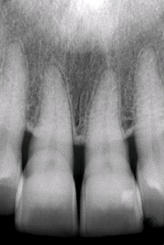
Evaluation of Periodontal Therapy
Reestablishment of the interproximal crestal cortex and the sharp line angle between the cortex and lamina dura are good indicators of stabilization of the disease, although these signs are not seen in all patients.
therefore, healing is best assessed clinically

Slide 37
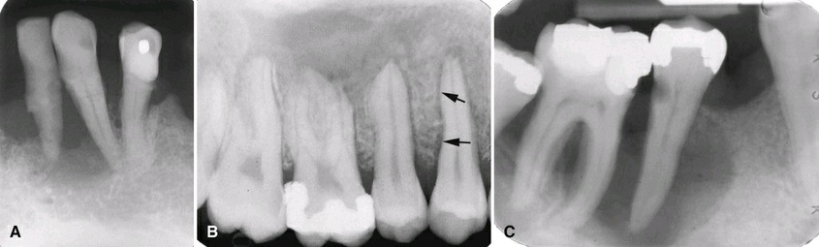
Differential Intepretation
The most likely clinical sign of disease other than periodontal disease is the presence of one or a few adjacent loose teeth when the rest of the mouth shows no signs of periodontal disease
Periodontal disease originates: gingival sulcus at the alveolar crest, / bone loss larger at the coronal aspect and less severe apically
Malignant neoplasms—in particular, SCC—: mimic the appearance of periodontal disease/ extensive bone destruction / Irregular widening of the PDL / ragged or irregular periphery, and destruction of the lamina dura
In some cases>>> clinical characteristics of the lesion and the failure to respond to treatment indicate the presence of malignancy.

Slide 38
Langerhan cell histiocytosis
single or multiple regions of bone destruction
“teeth floating in space” may appear similar to severe periodontitis
epicenter of the bone destruction is in the midroot level
“ice cream scoop” appearance

